Slide 1
Smithsonian Provenance Research Initiative (SPRI)
Office of the Under Secretary for History, Art, and Culture,
Smithsonian Institution, Washington, D.C.
SPRI Team
Jane Milosch, Director
Laurie Stein, Senior Provenance Advisor
Lynn Nicholas, Project Advisor
Nick Pearce, SPRI Senior 2014-2016, and Richmond Chair of Fine Art, University of Glasgow, U.K.
Andrea Hull, Program Associate
Johanna Best, Program Manager for Scholarly and Public Engagement, Mellon/ACLS Fellow
Colleen Carroll, Program Associate
SPRI and Freer Gallery of Art & Arthur M. Sackler Gallery
Elizabeth Duley, Head of Collections
Jeffrey Smith, Asst. Registrar for Collections Information Technology

Slide 2
THE SMITHSONIAN INSTITUTION, WASHINGTON, D.C.
Our Mission: The increase and diffusion of knowledge
Collections are held in public trust for the American people
Our Vision: Shaping the future by preserving our heritage, discovering new knowledge, and sharing our resources with the world
Sharing expertise and resources with more than 100 countries
19 museums and galleries and the National Zoological Park
Total number of artifacts, works of art and specimens estimated at 137 million
Smithsonian maintains 1.5 million library volumes, including rare books and 89,000 cubic feet of archival material.

Slide 3
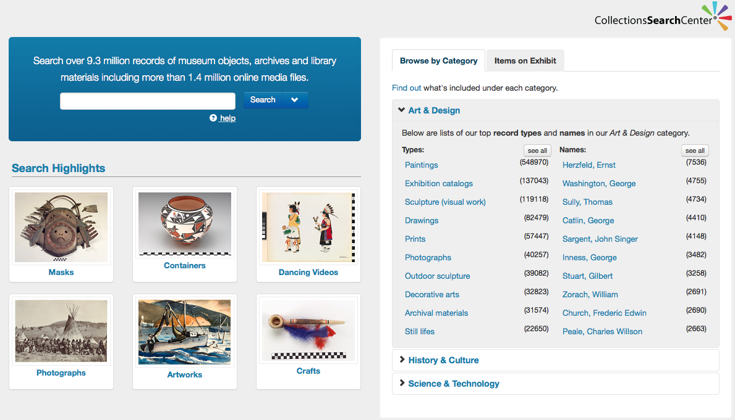

Slide 4
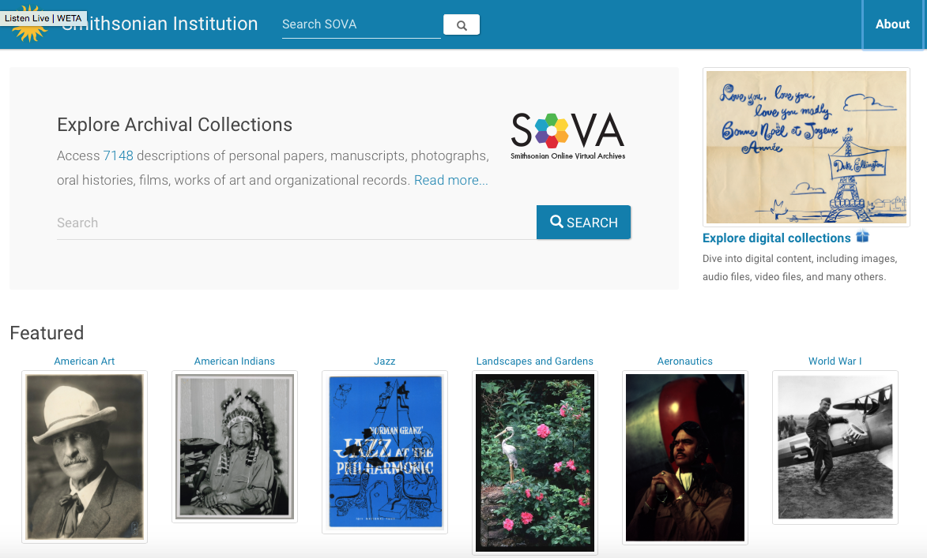

Slide 5
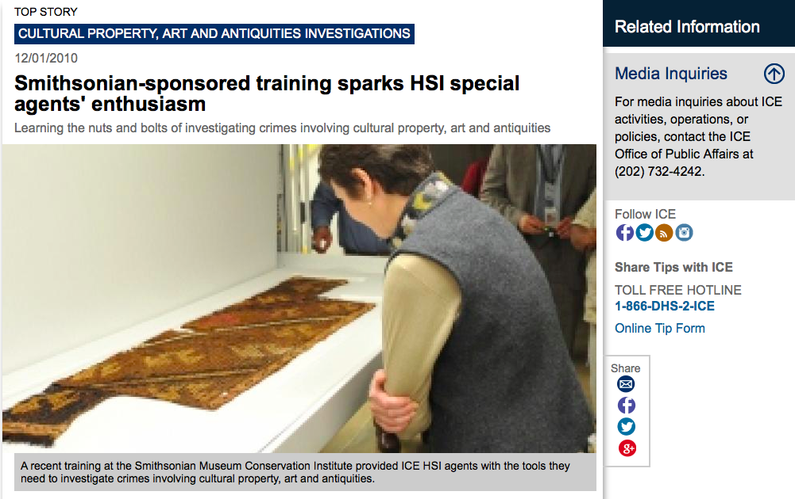

Slide 6
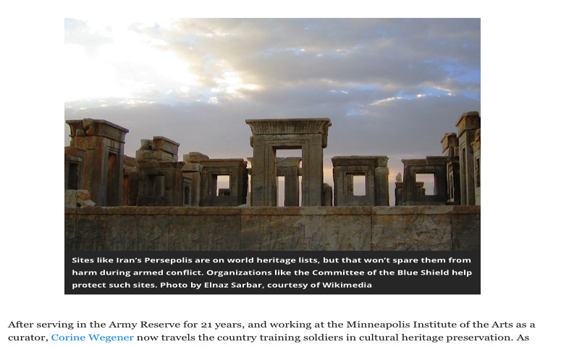
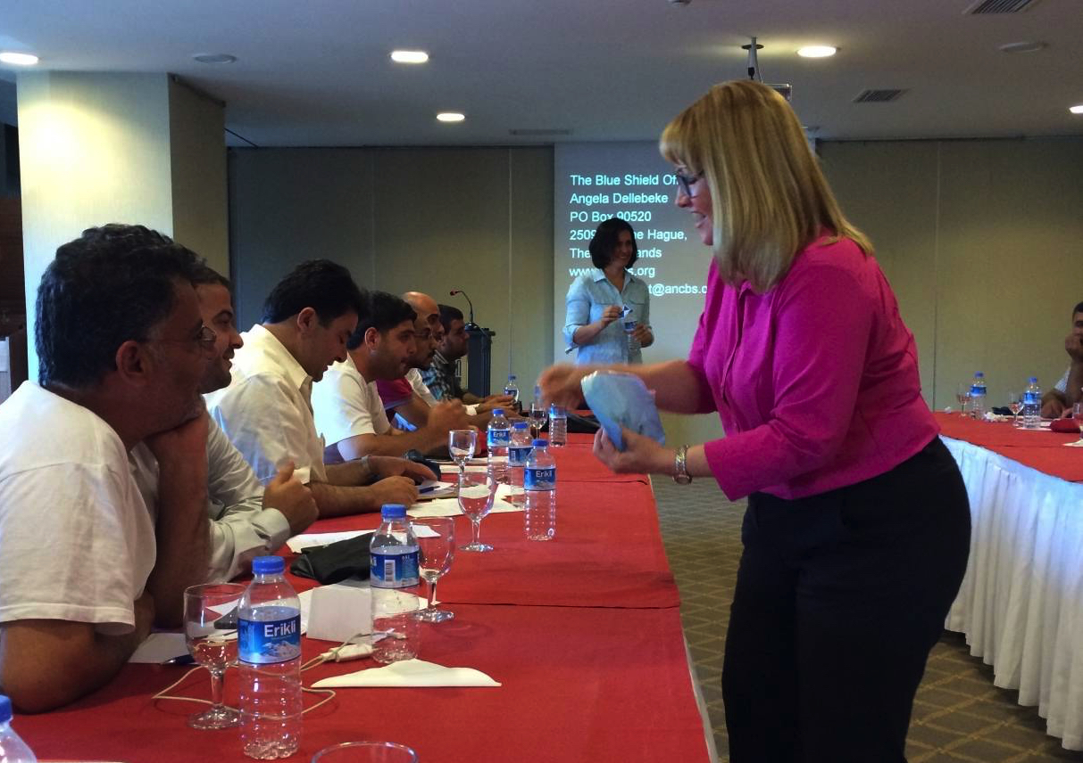
The SHOSI Project:
Workshops
Emergency Care for Syrian Museum Collections

Slide 7
Smithsonian Provenance Research Initiative (SPRI)
National Museum of African Art
National Museum of American History
National Portrait Gallery
Smithsonian American Art Museum
Archives of American Art (AAA)
Cooper-Hewitt, National Design Museum
Freer Gallery of Art & Arthur M. Sackler Gallery
Hirshhorn Museum & Sculpture Garden
National Museum of African Art
National Museum of the American Indian

Slide 8
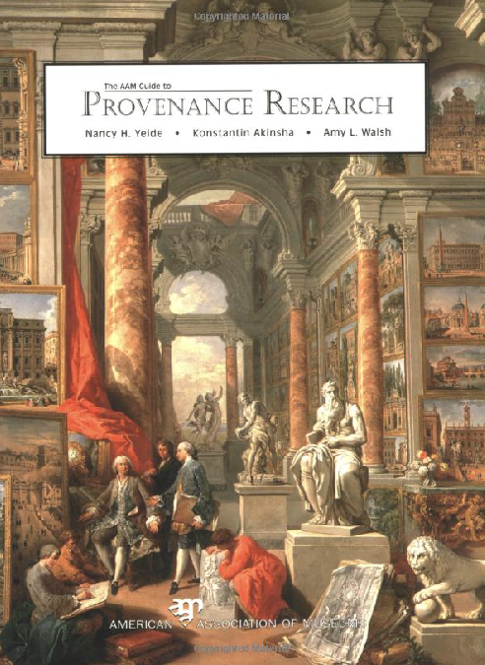
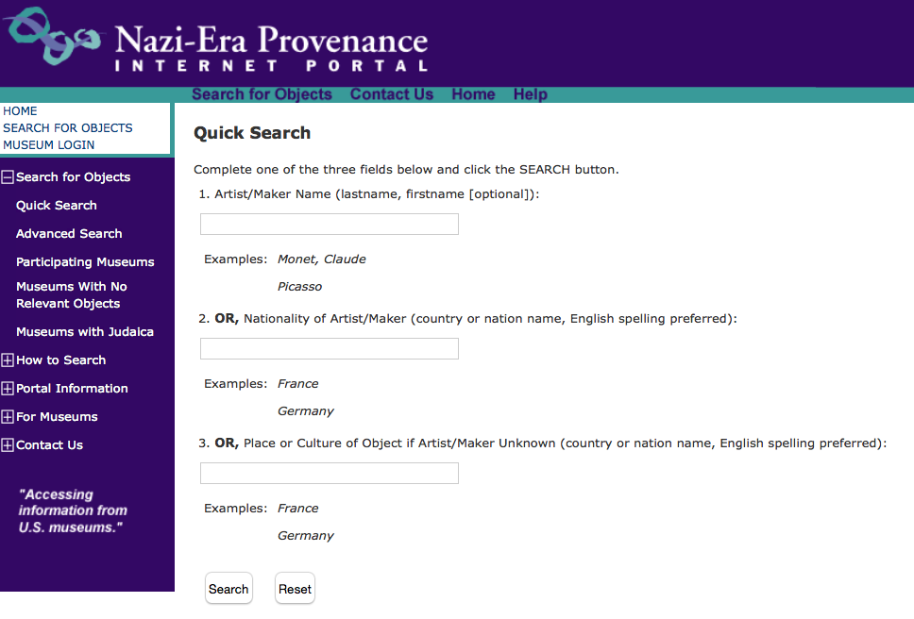
The AAM Guide to Provenance Research by Nancy Yeide, Konstantin Akinsha and Amy Walsh, 2001
Notes:
What is Provenance?
Provenance Literal meaning = origin
- Provenance is the life of a work of art
- Tracing the ownership and location of an object from its creation to present
- Identifies the artist, his/her nationality, name of work, size, medium, and history of ownership.
Provenance
Helps determine the authorship of a work
Establishes legal ownership of that work
Brings insight into the interests, taste, and culture of the individual who owned it (Also social and economic history provide insight into reasons of assembly and disassembly of collections.)

Slide 9
The Smithsonian’s WWII-era Provenance Project
Website launched in 2004
http://provenance.si.edu
Explains the historical background and current relevance of Nazi-era art theft and the complexities of provenance research
Provides links to resources such as the Nazi-Era Provenance Portal, AAM, government sites, lootedart.com

Slide 10
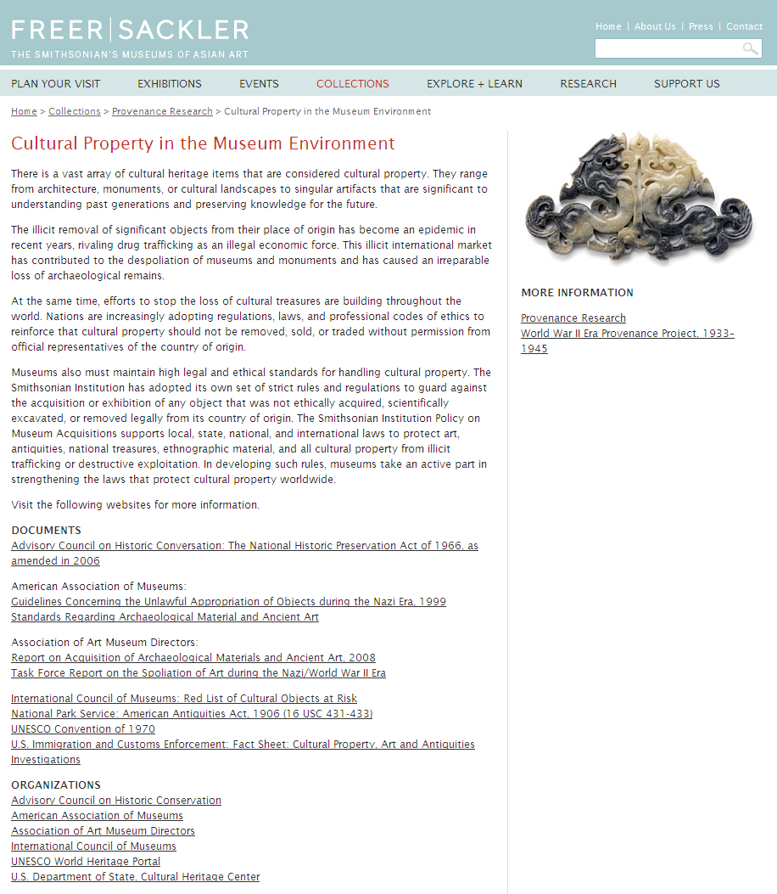
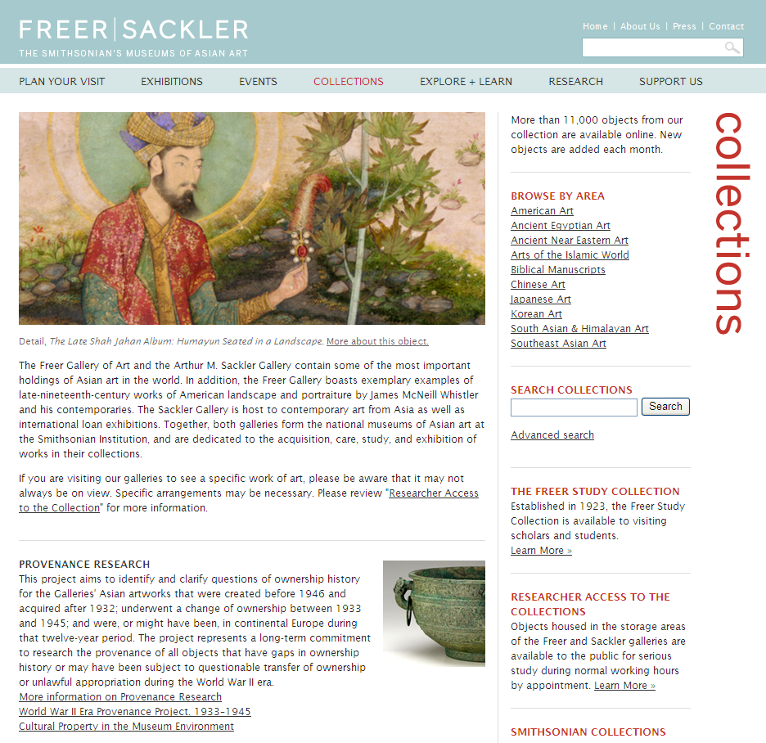
Provenance Research: Freer Gallery of Art & Arthur M. Sackler Gallery
Notes:
Freer and Sackler Galleries Provenance Project website
213 recently researched objects from the Freer collection with fully researched records, with 148 records currently available online.
Provides a PDF of the “Guidelines and Procedures for WWII Provenance Issues” workbook, containing resources for scholars and the public.
Of the 9687 C.L Freer objects in the FSG’s permanent collection, all but 2500 have been formatted.
Separate from case-specific research, the process of formatting records leads to the creation of a rich constituent database of information pertaining to dealers, collectors, and donors.
Despite extensive archival research, gaps of knowledge for the years 1932-1946 still exist for a number of records.

Slide 11
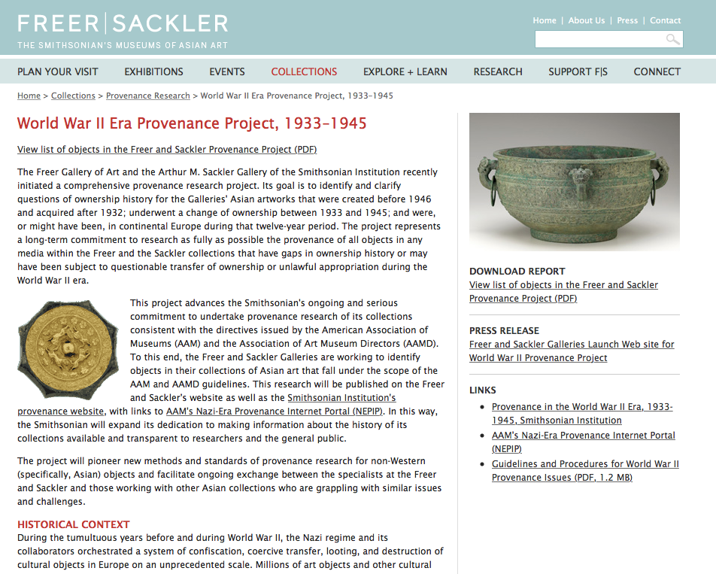
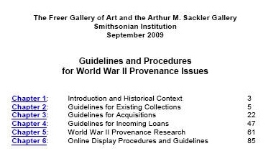
SPRI: Freer and Sackler Galleries
Since 2009, nearly 400 Asian artworks have been researched and searchable on FSG website
Downloadable workbook for Asian Art WWII-era Provenance Research

Slide 12
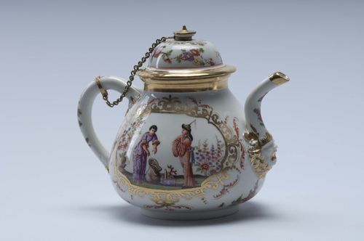
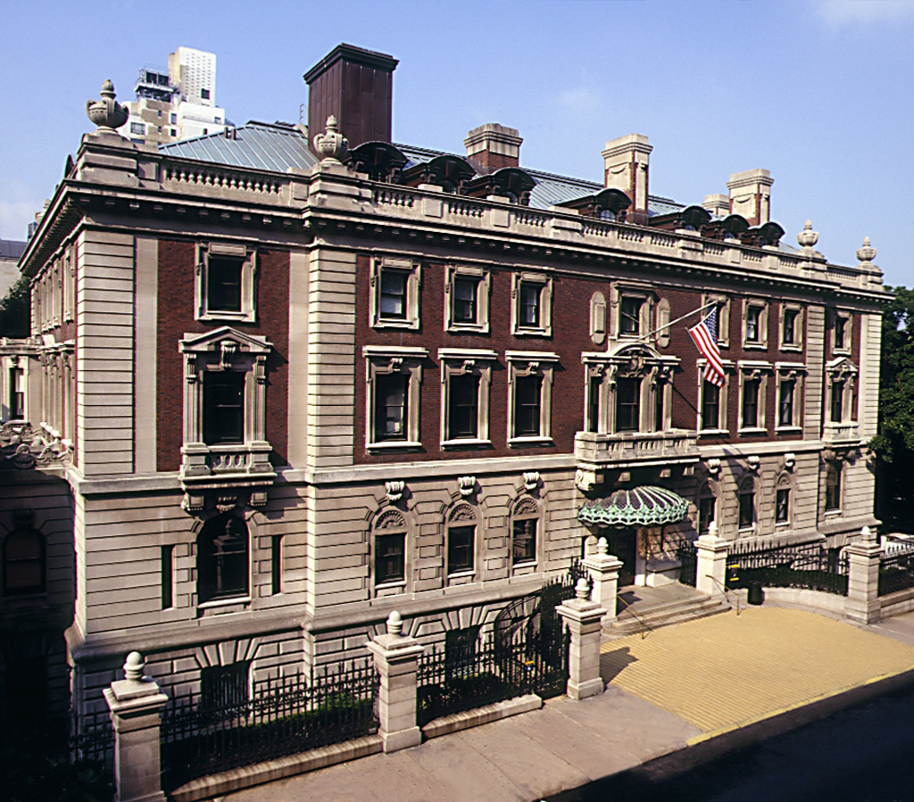
SPRI: Decorative Arts Provenance Research Projects
National Museum of American History, Washington, D.C.
Cooper-Hewitt National Design Museum, New York
Hans Syz European Porcelain Collection, donated to American History Museum in 1961, Meissen Chinoiserie teapot and cover, 1724-25, catalog 74.130ab

Slide 13
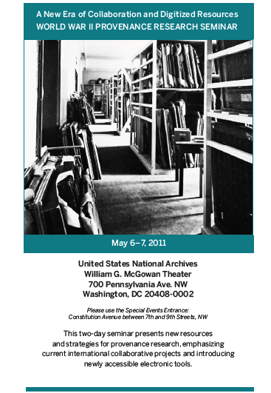
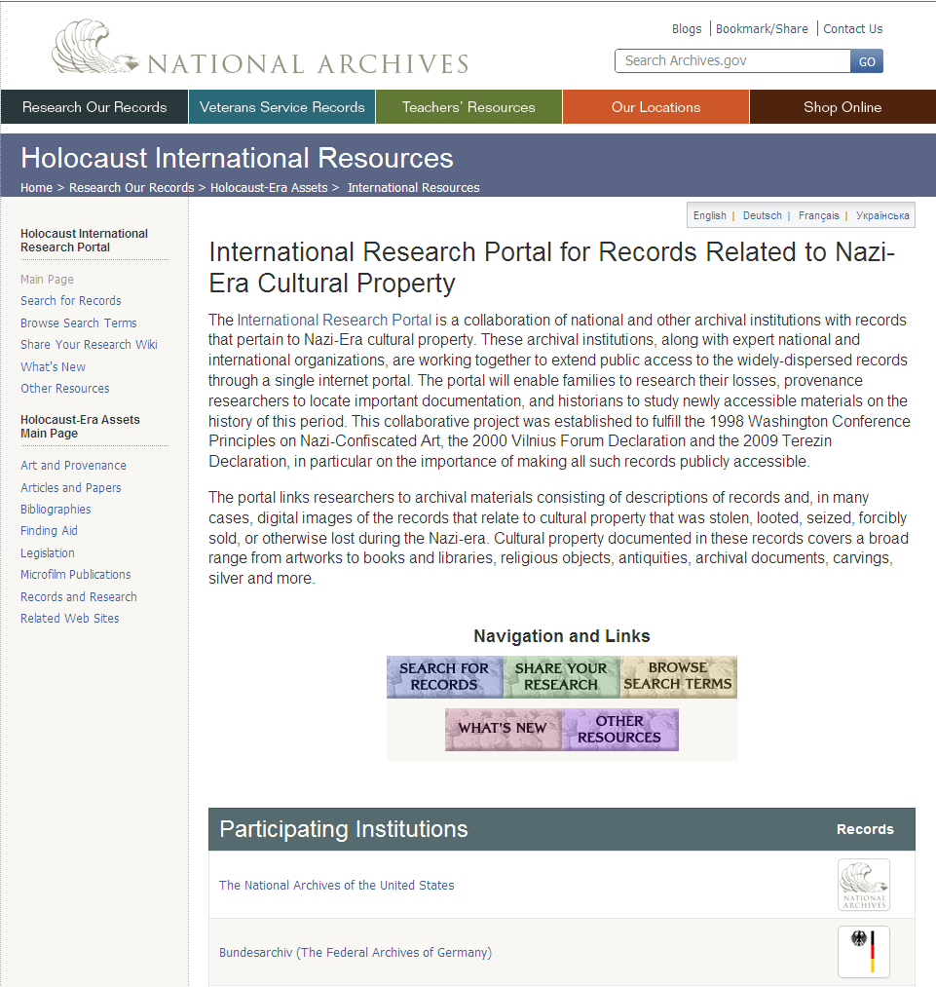
2011 International Seminar at the National Archives and Records Administration: Information about New Online Resources at archives around the world

Slide 14
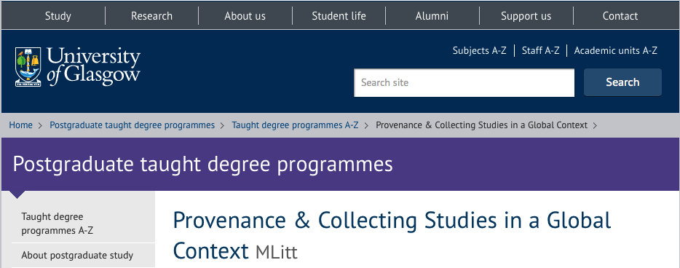
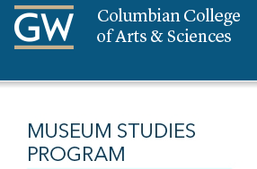
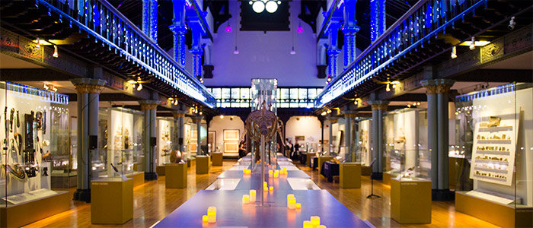
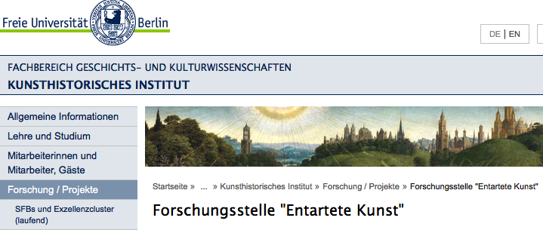
New International Graduate Program Partnership
Coming Soon!

Slide 15
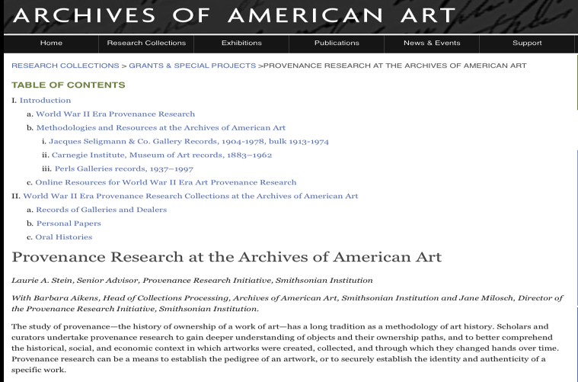
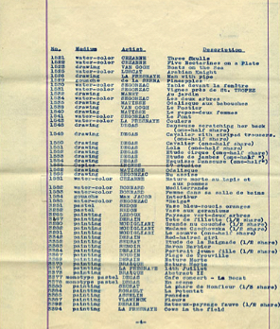
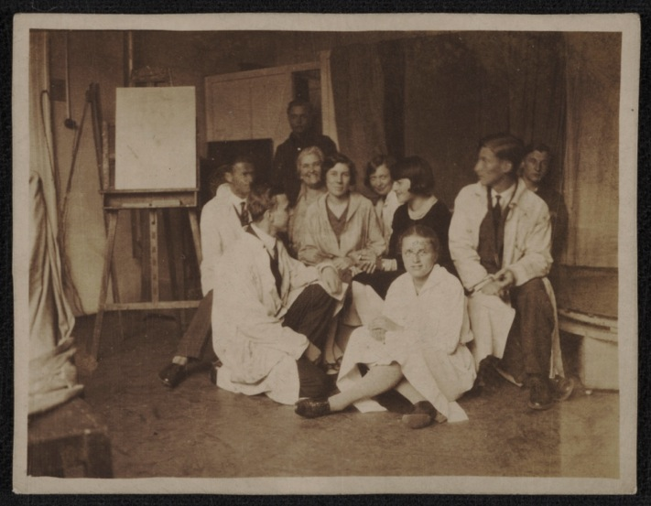
Technology and Shared Resources: Archives of American Art
Jacques Seligmann & Co. records, 1904-1978 (bulk 1913-1974). Archives of American Art.

Slide 16
CARP
Chinese Art Research into Provenance

Slide 17
What is CARP?
CARP is a fully-searchable database of sources for provenance research of Chinese works of art in The Burrell Collection, delivered as a free, on-line resource.
The database provides full records of Sir William Burrell’s (1861-1958) purchases which can be traced back to previous owners through auction and dealer archives.

Slide 18
Funded through the AHRB’s Innovations Awards Scheme, the project ran for 12-months and was designed to test the feasibility and methodology for establishing provenance of Chinese works of art.
The Burrell Collection was chosen because it was a collection of a single individual who kept detailed records of his purchases and whose pattern of collecting was representative of western collectors of Chinese art during the late 19th-early 20th century.

Slide 19
Aims and Objectives
To identify a finite list of collectors and dealers from whom Burrell acquired his Chinese art (approx 125 names were recorded)
To record images of collectors’ & dealers’ marks (approx 500 were recorded)
To develop a data file on each collector & dealer (around 1,925 data files were created)
To locate extant collections-related business and other records and document their status
To make the results publicly available in a database on the web

Slide 20
Methodology
Researching Burrell’s Purchase Books
Library and archive research using primary and secondary sources
Accessing auction-house and dealer records held by companies still in business and those held privately
Web-sites (institutional, databases,etc)
Mapping of custom-designed database to web-site.

Slide 21
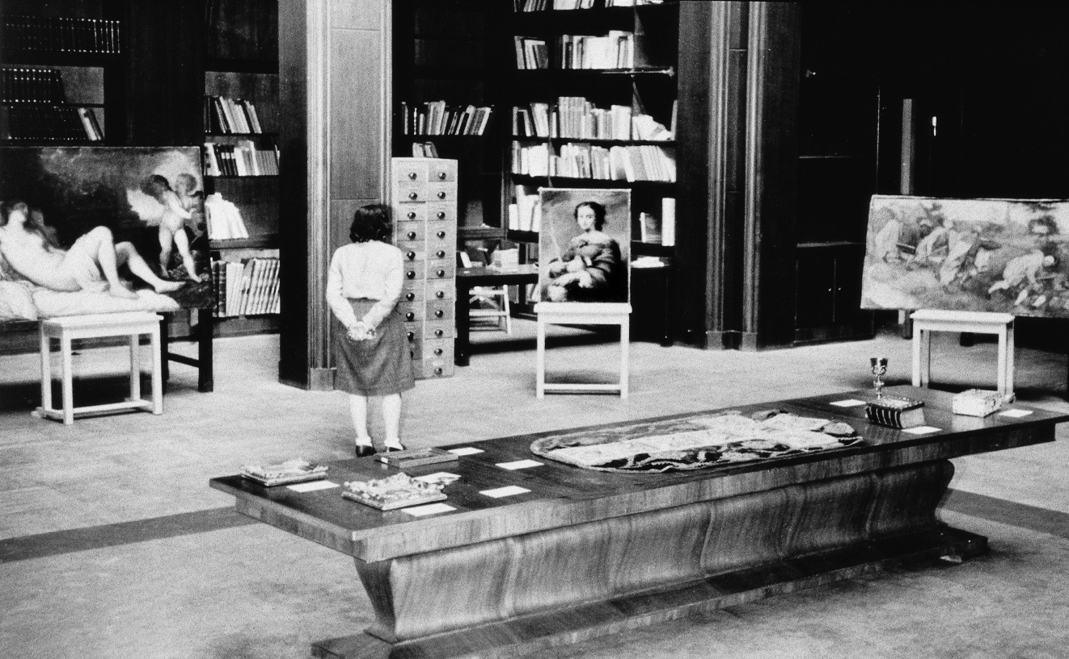
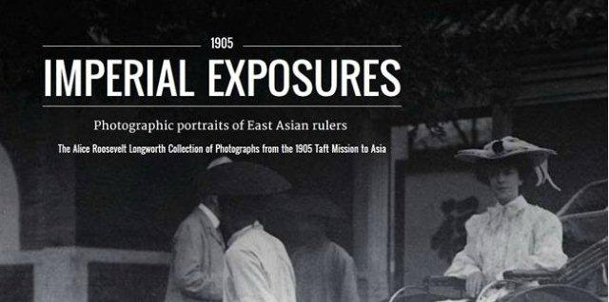
Effective Provenance Research = International Collaboration and Scholarly Exchange
Technology is constantly changing:
- the way we do research and exhibitions
- how information is shared and disseminated, from libraries, museums, and archives,
to online portals, exhibitions, and databases
FSG archival exhibition Google Cultural Institute
Munich Central Collecting Point, Allied Restitutions 1945

Slide 22
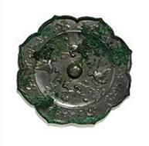
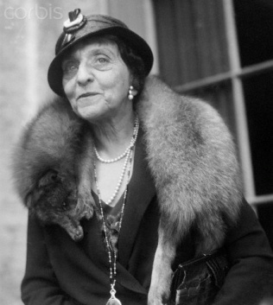
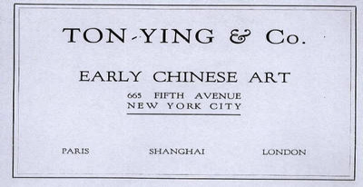
Foliated mirror with felines and birds, Mirror
Middle Tang dynasty, 8th century, China
Bronze, Diam x D: 19.3 x 1.4 cm, Purchase, Freer Gallery of Art, F1944.4
WWII-era Asian Art Collector/Dealer Web Resource
Foliated mirror with felines and birds
Mirror
Middle Tang dynasty, 8th century
China
Bronze
Diam x D: 19.3 x 1.4 cm
Purchase
Freer Gallery of Art
F1944.4
From at least 1929
Mrs. Christian R. (Bettie F.) Holmes (1871-1941), New York and "The Chimneys," Sands Point, Port Washington, Long Island, from at least 1929 [1]
From at least 1944
Tonying & Company, New York, from at least February 1944 [2]
From 1944
Freer Gallery of Art, purchased from Tonying & Company on February 7, 1944 [3]
Events currently linked to the Tonying and Company
Provenance: sale: February 7, 1944
Seller: Tonying and Company
Buyer: Freer Gallery of Art
Events
sales, gifts, transfers
auctions, exhibitions
⬅
People
individuals, institutions
⬆
Notes:
[1] See Yamanaka & Company, To-So Seikwa: Select relics of the Tang and Sung Dynasties from the Collections in Europe and America (Osaka, 1929), vol. 2, pl. 39.
[2] See Tonying & Company’s invoice, dated February 7, 1944, in which the mirror figures under no. B. 33: “Bronze Polyfoliate Mirror, designs of floral scrolls, flying Phoenixes, etc. / Tang.” copy in object file. The acquisition was approved by C. G. Abbot, the Secretary of the Smithsonian Institution, on February 4, 1944, see “List of Objects Contemplated for Purchase by the Freer Gallery of Art,” copy in object file.
Media
documents, catalogues, images
Mrs. Christian Ramus
(Bettie Fleischmann) Holmes (1871-1941),
Collector and philanthropist.
[3] See invoice cited in note 2. See also A. G. Wenley’s letter to C. F. Yau, Tonying & Company, dated February 5, 1944, in which Wenley confirms the purchase of the mirror along with seven other mirrors from the Holmes collection (see records for F1944.3, F1944.5-F1944.10).

Slide 23
“Provenance Research in American Museums and Archives,” in Collections: A Journal for Museum and Archives Professionals, AltaMira, 2014
12 Essays by independent scholars and professionals affiliated with 9 American institutions include:
Archives of American Art, Washington, D.C.
Freer Gallery of Art and Arthur M. Sackler Gallery
Harvard Art Museums, Cambridge, Mass.
The J. Paul Getty Research Institute, Los Angeles
Metropolitan Museum of Art, New York
Philadelphia Museum of Art
Solomon R. Guggenheim Museum, New York
National Gallery of Art, Washington, D.C
Museum of Fine Arts, Boston
Walters Art Museum, Baltimore

Slide 24
International Programs with SPRI in 2016
AMERICAN ALLIANCE OF MUSEUMS 2016 ANNUAL MEETING
May 26-29, 2016, Washington, DC
Today’s Looted Art = Tomorrow’s Provenance Problem
Dr. Richard Kurin, Under Secretary for History, Art, and Culture, Smithsonian Institution
Prof. Dr. Hermann Parzinger, President , Stiftung Preussischer Kulturbesitz, Berlin
Dr. Gerard Vaughan, Director of the National Gallery of Australia, Canberra
Sharon H. Cott, Senior Vice President, Secretary, and General Counsel, Metropolitan Museum of Art, New York
Dr. Patty Gerstenblith, Chair of the State Department’s Cultural Property Advisory Committee, and Director of the Center for Art, Museum and Cultural Heritage Law at DePaul University College of Law, Chicago, Illinois
COLLEGE ART ASSOCIATION’S 2016 ANNUAL CONFERENCE
Feb. 3-8, 2016, Washington, DC
Awareness →Professionalization →Career Opportunities?
Teaching Provenance Research in the Field of Art History
Christian Fuhrmeister, Zentralinstitut fuer Kunstgeschichte, Munich
Meike Hoffmann, Wss. Mitarbeiterin und Projektkoordinatorin, Forschungsstelle "Entartete Kunst", Kunsthistorisches Institut/Free University of Berlin
Christel H. Force, Associate Research Curator for Modern and Contemporary Art, the Metropolitan Museum of Art.
MaryKate Cleary, Director of Research, Art Recovery International
Megan Fontanella, Associate Curator, Collections and Provenance, Solomon R. Guggenheim Museum
Nick Pearce, Sir John Richmond Chair of Fine Art, School of Culture & Creative Arts, University of Glasgow; Senior Fellow Smithsonian Provenance Research Initiative, 2014-15

Slide 25
German/American Provenance Research
Exchange Program (PREP) for Museum Professionals, 2017-2019
Smithsonian
SPK/Berlin State Museums
The Metropolitan Museum of Art, New York
The Getty Research Institute, Los Angeles
The German Lost Art Foundation
The Dresden State Museums
Germany’s Central Institute for Art History, Munich
$1M funding and partnership commitment
2017-2019
Each year, two week-long workshops for 20-30 German and American museum professionals
1st Meeting at the MET, Feb 5-10, 2017, and 2nd in Berlin, Sept 2017

Slide 26
Participants
German/American Provenance Research Exchange Program (PREP)
International
Interdisciplinary
Curators
Provenance Researchers
Archivists
Collections Managers
Registrars
Lawyers
Education Specialists
Information Technology Specialists
Pre-Doctoral Students
Pre- and Post-Doctoral Researchers
USA | Germany
Organizer (SI/Washington) | Organizer (SPK/Berlin)
Partner (Met/New York) | Partner (ZIKG/Munich)
Partner (Getty/Los Angeles) | Partner (SKD/Dresden)
Provenance researcher | Provenance researcher
Provenance researcher | Provenance researcher
Provenance researcher | Provenance researcher
Curator/Archivist | Curator/Archivist
Collection Managers/ Lawyers / Educator /IT etc | Collection Managers/ Lawyers / Educator /IT etc
Collection Managers/ Lawyers / Educator /IT etc | Collection Managers/ Lawyers / Educator /IT etc
Student / Researcher (pre-/post-doc) | Student / Researcher (pre-/post-doc)

Slide 27
Schwabinger Kunstfund (Gurlitt) Task Force

Slide 28
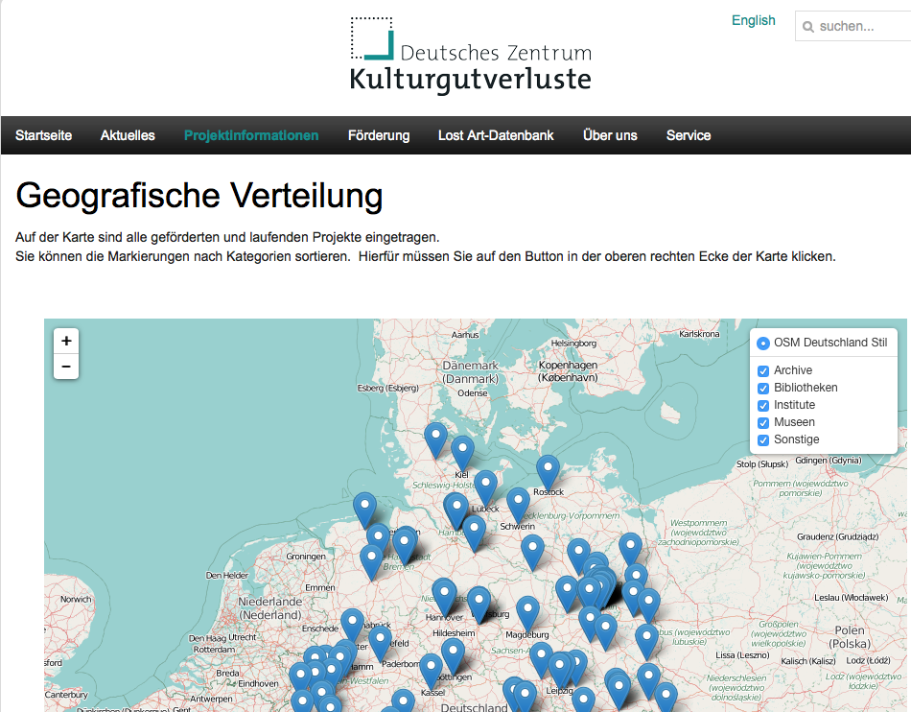
PREP Partner: The German Lost Art Foundation
Lost Art Database

Slide 29
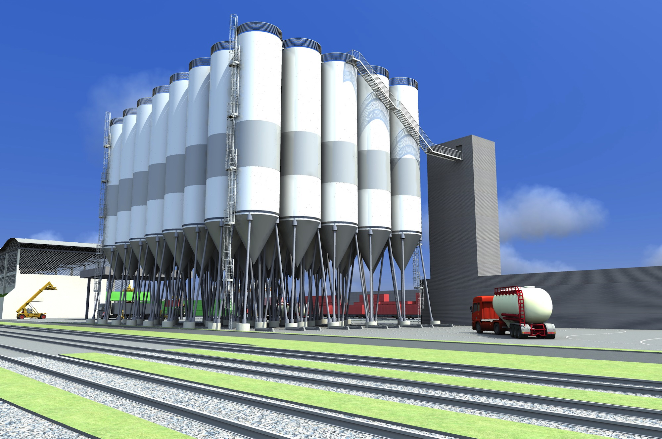
We need to CONNECT the Silos
➔

